Slide 1


Data and Knowledge in Telemedicine
Rafael C. Alvarado, Ph.D.
Program Director and Associate Professor (AGF) School of Data Science University of Virginia (US)
Universidad de Guayaquil 4 December 2020

Slide 2
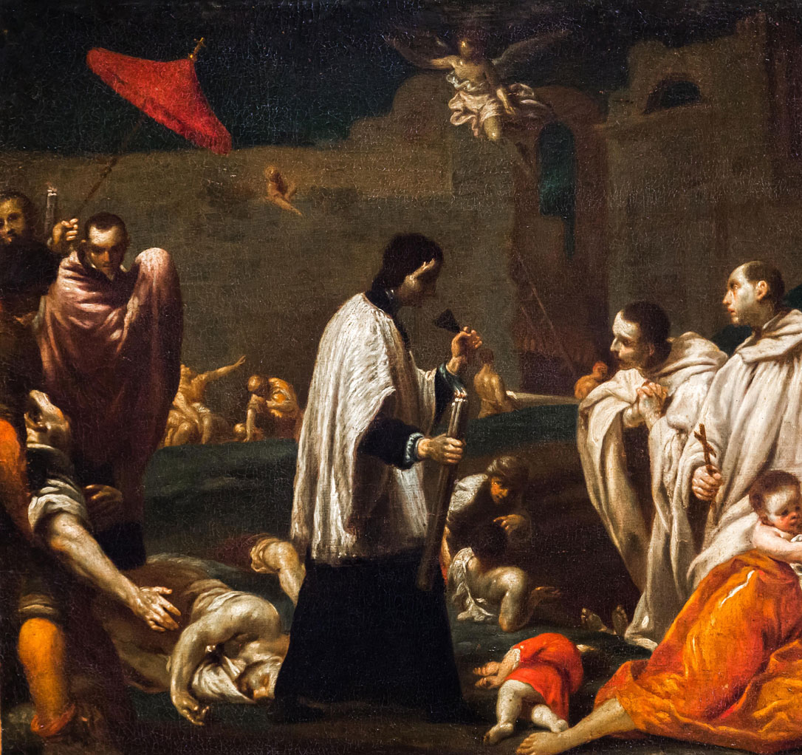
COVID19 will transform social institutions as did the Black Death of the 14th century
We are witnessing a great transformation in the organization of labor through a mass migration of services online
Education, business, and medicine are all being affected
Black Death Blessed Bernard Tolomei Interceding for the Cessation of the Plague in Siena, oil on copper by Giuseppe Maria Crespi, c. 1735. Active Museum/Alamy
Notes:
Black Death Blessed Bernard Tolomei Interceding for the Cessation of the Plague in Siena, oil on copper by Giuseppe Maria Crespi, c. 1735.
Active Museum/Alamy
https://www.britannica.com/event/Black-Death/Effects-and-significance

Slide 3

Changes in US Telemedicine due to COVID19
Medicare will pay the same rate to physicians for telehealth services
Patients can be in their homes to receive telehealth services
Patients do not need an existing relationship with the attending physician
Physicians may waive or reduce cost-sharing for telehealth visits
Physicians licensed in one state may see a patient in a different state
https://www.ama-assn.org/practice-management/digital/5-huge-ways-pandemic-has-changed-telemedicine

Slide 4
What is Telemedicine?
The remote delivery of healthcare services, especially via networked computer media. In the US, it is usually defined as:
Interactive Medicine: patients and physicians communicate in real-time
Store-and-Forward: providers share patient information with a practitioner in another location
Remote Patient Monitoring: remote caregivers monitor patients at home using mobile data-collecting devices
P
D2P
Interactive
Monitoring
D₁
Store-and-forward
D₂
D2D
https://vsee.com/what-is-telemedicine

Slide 5
Telemedicine as Assemblage
D₁
Interactive medicine
SENSORS
P₁
Apps
PLATFORM
P2P?
SENSORS
P₂
D₂
Store-and-forward
DATA
Remote monitoring
Sensor data, electronic health records, transactional data, metadata, etc.

Slide 6
Examples
Locus Health (locushealth.com)
Tailored remote monitoring, patient engagement and navigation platform, focused on key adult populations like cardiac rehab, oncology, and transplant, as well as vulnerable pediatric conditions.
Flowlab (flowlab1.com)
An integrated system delivering remote, real-time training access and psychological support to warfighters and operators anywhere in the world.

Slide 7
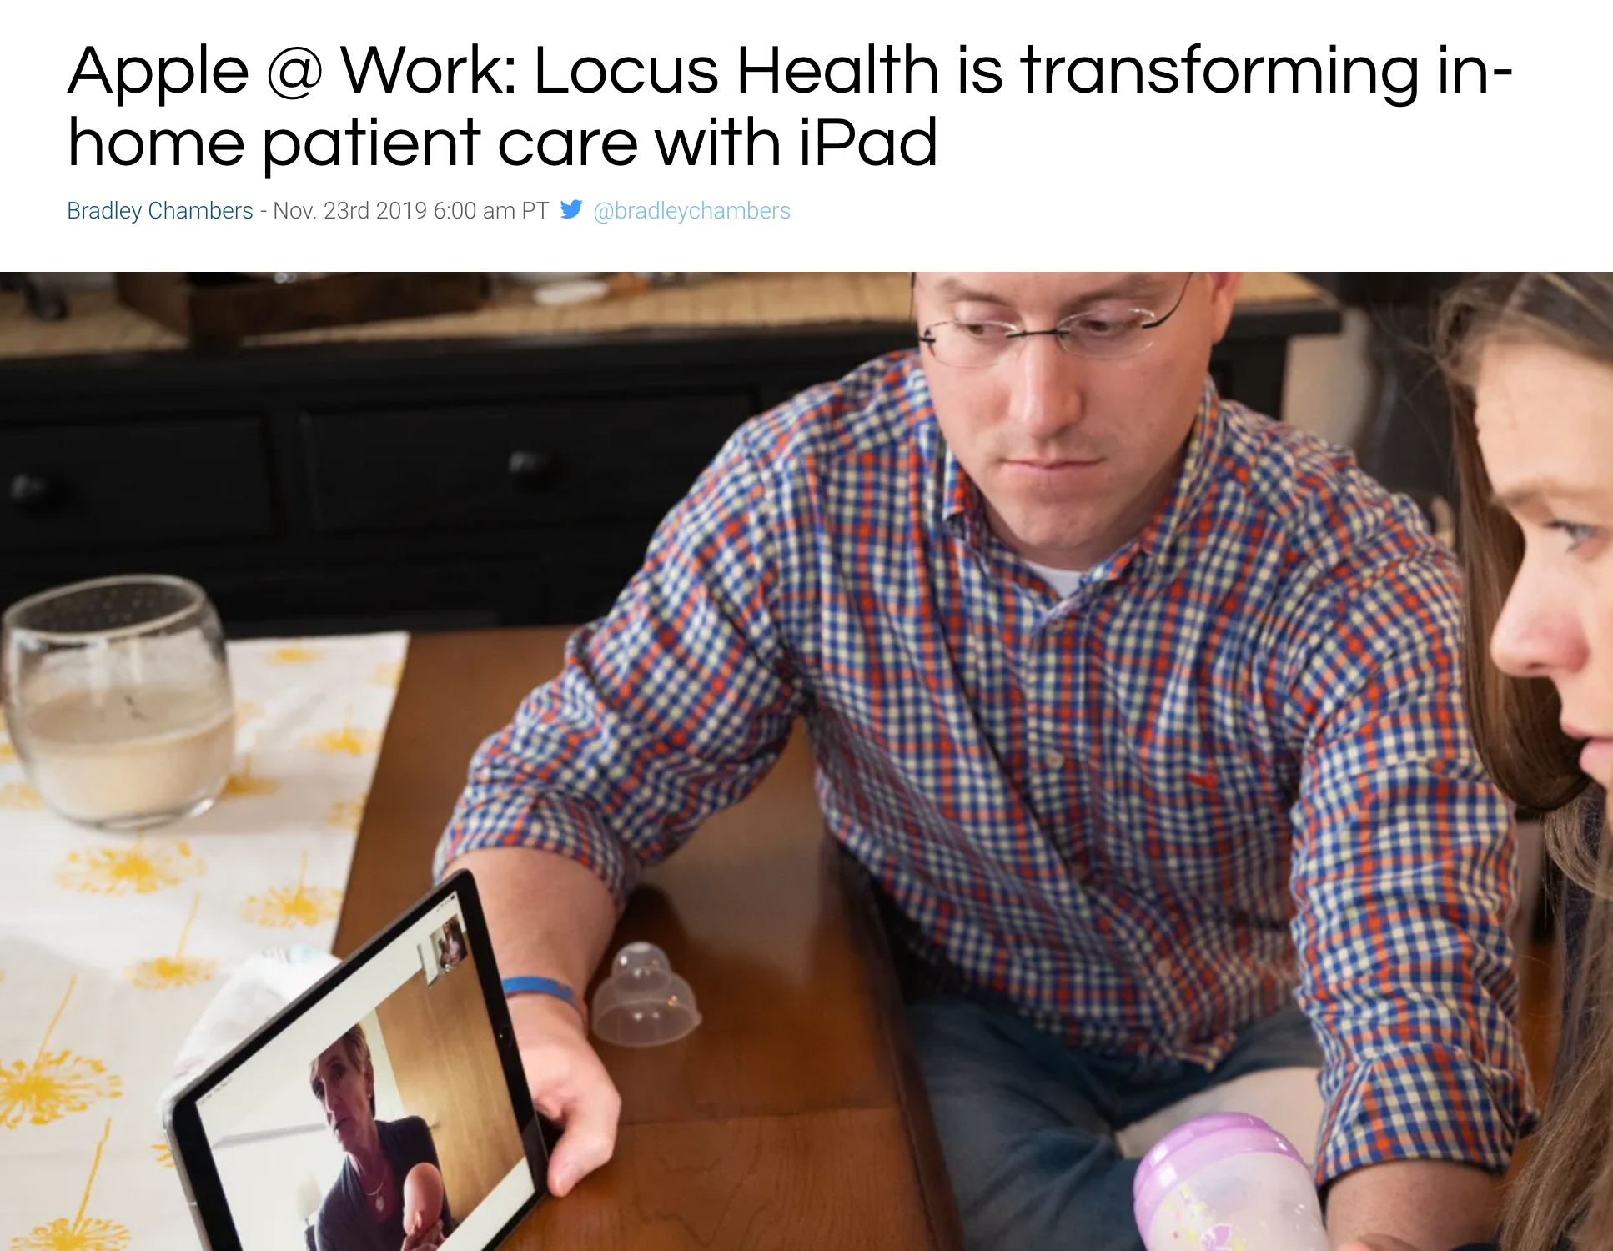
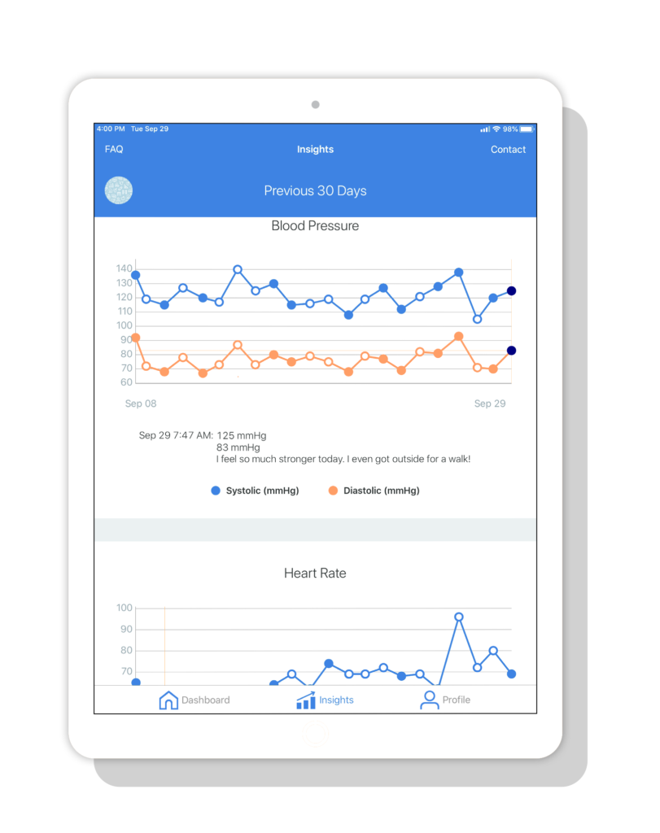

Slide 8
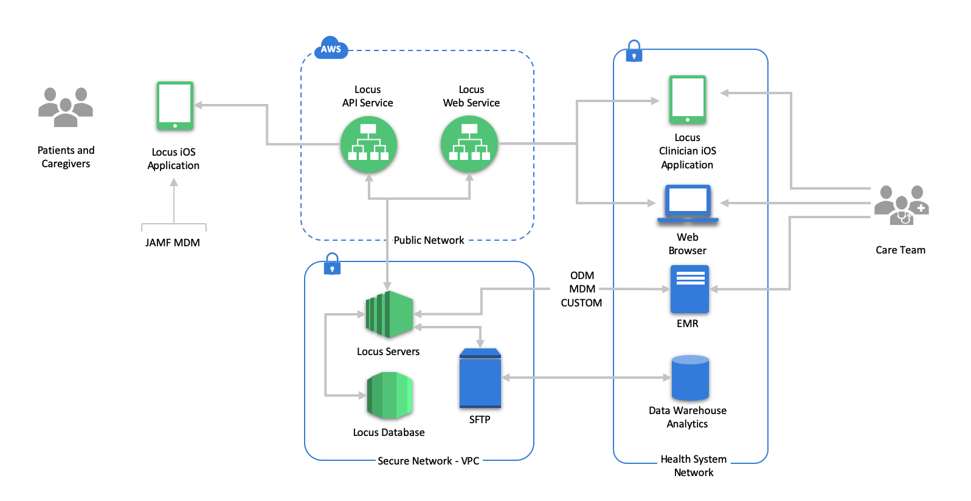
← DATA

Slide 9
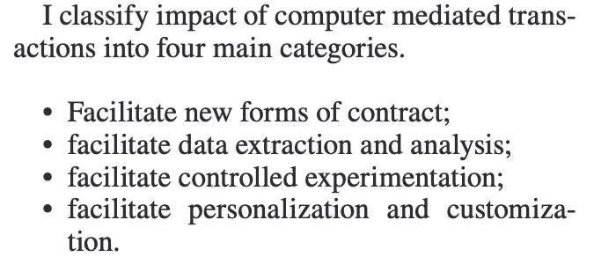
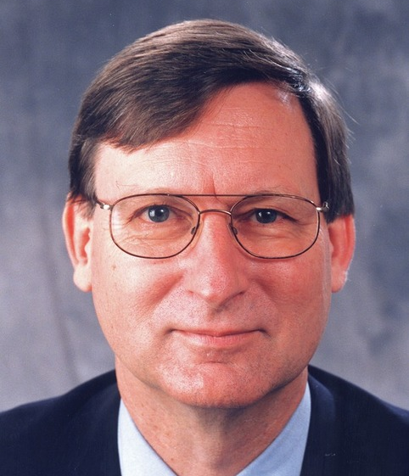
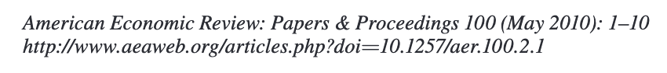
Computer Mediated Transactions
Hal Varian Google Economist

Slide 10
TM as Disintermediation
Computer mediated transactions enable distintermediation
Distintermediation is a form of socio-economic organization in which data serves as a dominant form of capital and as a social medium
Persistence of data makes the transaction possible (not just store-and-forward)
All transactions generates data
This has become a paradigmatic form of business

Slide 11
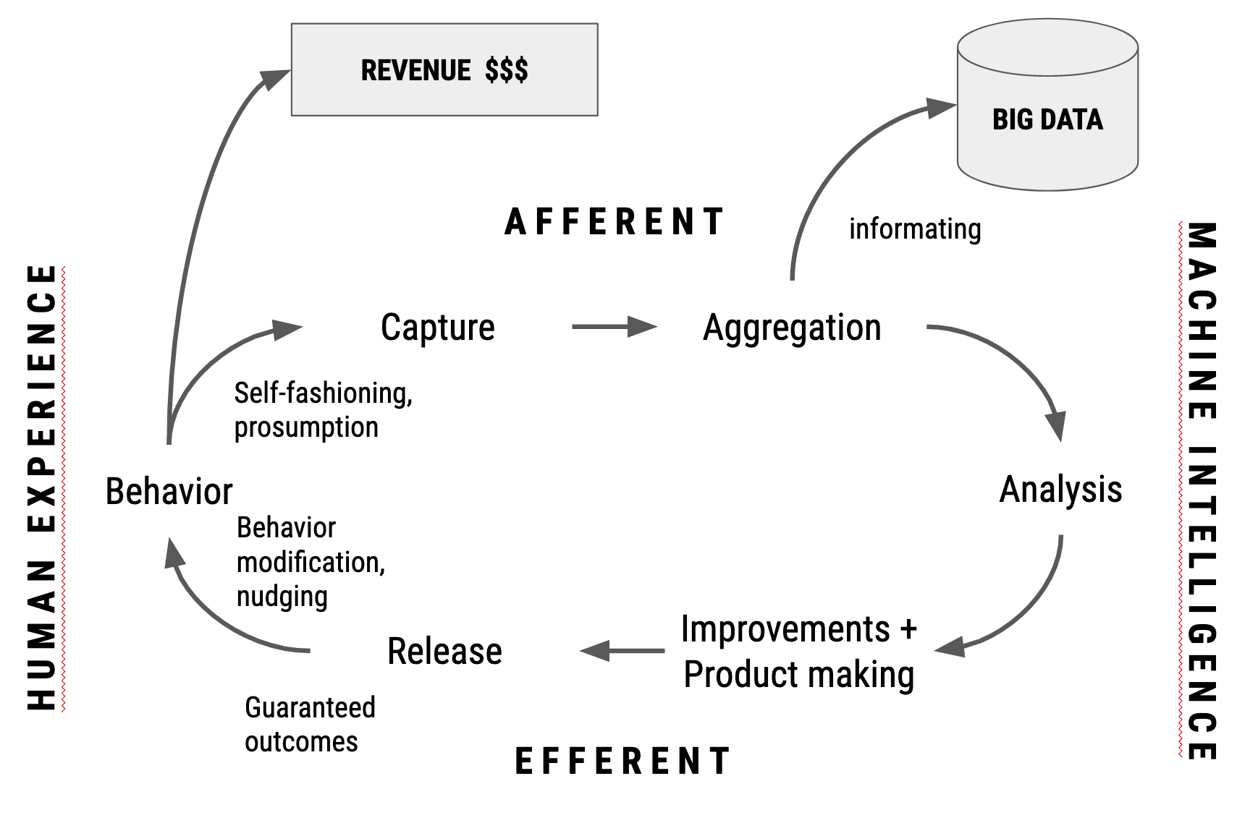
Summary of Zuboff’s Surveillance Capitalism
Notes:
S

Slide 12
The Role of Machine Intelligence
Machine Intelligence (MI) = Artificial Intelligence and Machine Learning
Where there is data, there is MI
MI already mediates the relationship between doctor and patient
The role of MI will grow as TM grows
This will have effects on the nature of medical knowledge

Slide 13
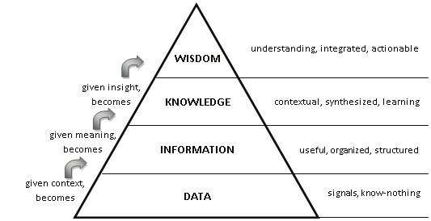
MI in the DIKW Pyramid
Machine Intelligence and AI

Slide 14
Some Current Uses of AI
Classification of images in radiology, mammography, MRIs, etc. using deep neural networks
Very effective: “The best model obtained had 95.7% accuracy, with 92.1% sensitivity and 99.4% specificity. When compared with experts on the field, the diagnostic accuracy of the model generated was significantly higher in a new set of 20 MRIs.”
Prediction of return visits
Real-time processing of sensor data (heart rate, etc.)
https://n.neurology.org/content/94/10/e1094

Slide 15
Driving Factors
“By 2020, there will be an estimated 2314 exabytes of healthcare data.” https://telemedicine.arizona.edu/blog/five-ways-big-data-advancing-telemedicine
“By 2020, telemedicine is expected to be a $35 billion industry and be an imperative piece of modern healthcare delivery.” https://vsee.com/what-is-telemedicine/
Online migration due to COVID19 and changes in laws
Advances in technology

Slide 16
The net effect I call “accelerated telemedicine” (ATM)

Slide 17
Effects of ATM on Medical Practice
The migration to TM will stimulate data regimentation
Integration of data sets through ontologies, etc.
Data regimentation will stimulate alignment of relations between doctor and patient
Practices will conform to imperatives of data
More pressure to use remote sensing and responding technologies (Internet of Things)
Data regimentation will also alter forms of knowledge …

Slide 18
Effects on Knowledge
In addition to concerns about privacy, confidentiality, and security, we should be aware of epistemic issues:
Biases in the data
Opacity of models
Amplification of theories
Vectorization of self, body, etc.

Slide 19
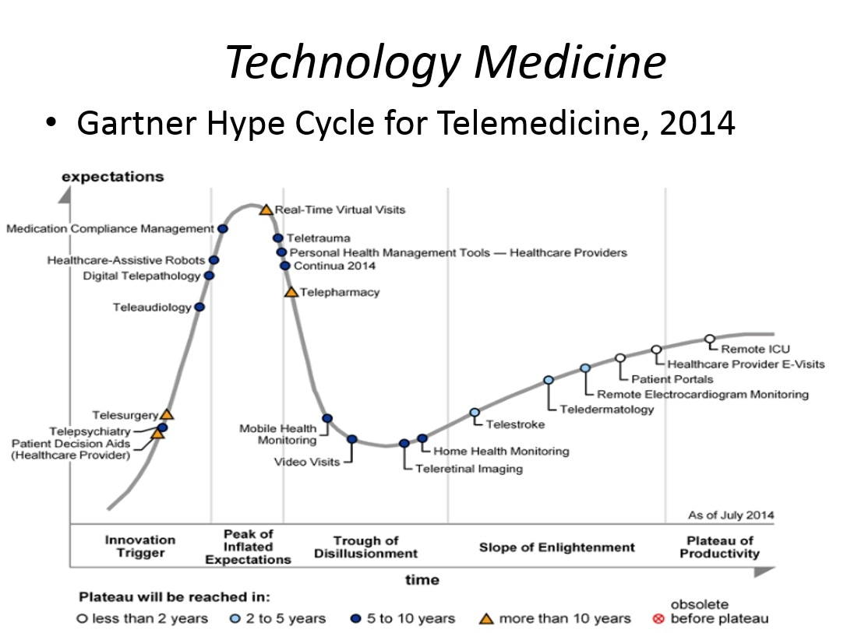

Slide 20
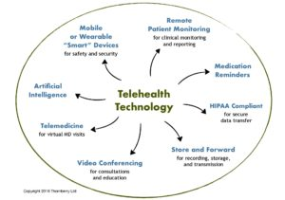
https://ndocsoftware.com/2019/09/telehealth-technology-future-calling/

